Slide 1
Gamification
and
Kahoot

Slide 2
What is gamification?
the use of game-design elements and game principles in non-game contexts
  to engage users and change behavior
More specifically:
  use of game-thinking and game mechanics in a non-game context in order to improve user engagement, crowdsourcing, ease of use, usefulness, learning etc.
An example: for websites, means to encourage users to engage in specific behaviors that increase the site use

Slide 3
Why use gamification?
"if you include notions of play, you can get people to do things they otherwise might not want to do.”
Gamification links with the following:
We like to play
We like to be good at things
We like to see how we measure up against others
We like to win
We like to compare with others
Notes:
And we like other people noticing the above

Slide 4
Why gamification?
Game is not the goal
Engaging users and changing their behavior is the goal

Slide 5
Game mechanics
What are game mechanics?
Tools and techniques that can be utilized to build a highly motivational user experience

Slide 6

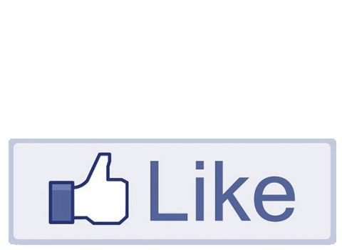
Game mechanics - examples
Voting

Slide 7
Game mechanics - examples
Follow

Slide 8
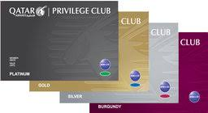
Game mechanics - examples
Collect

Slide 9
Game mechanics - examples
Unlock
Lottery

Slide 10
Game mechanics - examples
Grades/Points
  basic elements of a multitude of games and gamified applications
Leaderboards
  competitive indicators of progress that relate the player's own performance to the performance of others

Slide 11

Other Game mechanics
Badges
  visual representations of achievements
Performance graphs
  performance compared to preceding performance
Meaningful stories
  analogies of real-world settings
  can inspire or motivate players

Slide 12

Other Game mechanics
Avatars
Teammates
  bring conflict, competition or cooperation

Slide 13
Other Game mechanics
Achievements
Appointments
Behavioral Momentum
Blissful Productivity
Bonuses
Cascading Information Theory
Combos
Community Collaboration
Countdown
Discovery
Epic Meaning

Slide 14
Other Game mechanics
Free Lunch
Infinite Gameplay
Levels
Loss Aversion
Ownership
Progression
Reward Schedules
Status
Urgent Optimism
Virality

Slide 15
Common gamification techniques
Progress bars
Activity feeds
Real-time feedback
Virtual currency
Gifting
Challenges and quests
Trophy case
Mini games within other activities

Slide 16
Feedback loop
http://www.gamified.co.uk/user-types/#.U7wwMvldXDS

Slide 17
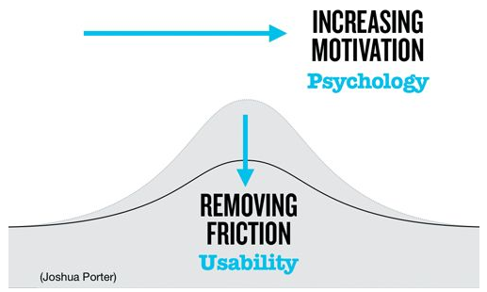
Gamification and psychology

Slide 18
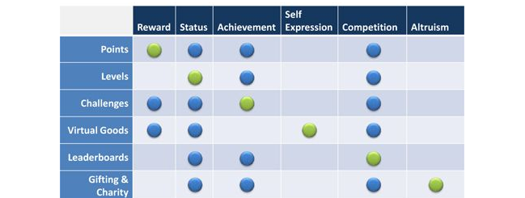
The Psychology of Gamification
How game mechanics relate to different psychology principles

Slide 19
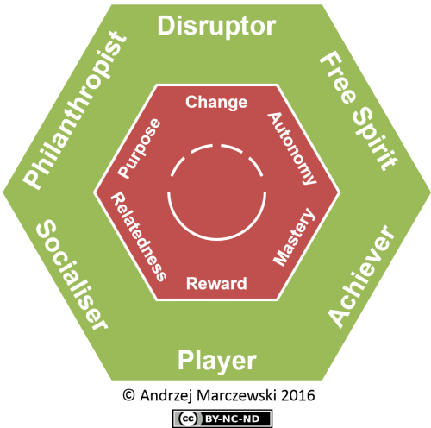
Breakout Session: User Types
http://www.gamified.co.uk/user-types/#.U7wwMvldXDS
http://www.gamified.co.uk/user-types/#.U7wwMvldXDS

Slide 20
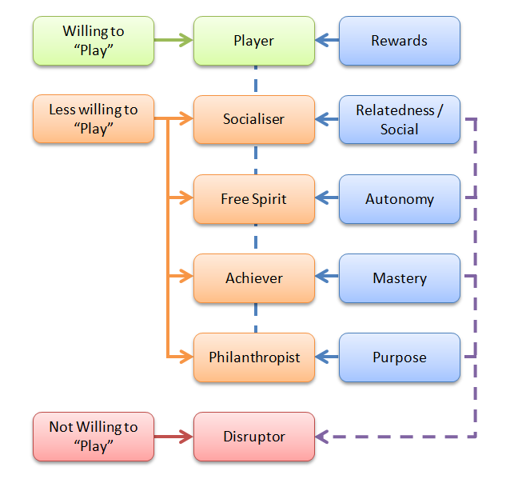
Breakout Session: User Types
http://www.gamified.co.uk/user-types/#.U7wwMvldXDS
http://www.gamified.co.uk/user-types/#.U7wwMvldXDS

Slide 21
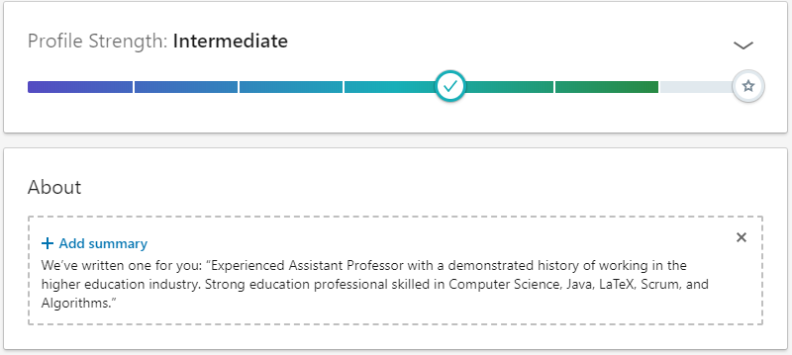
Other Gamification Examples

Slide 22
Other Gamification Examples
LinkedIn
Some issues:
  Reaches 100%: it could continue well beyond 100
  Have to complete the steps in order to progress
    There are indications on how steps can be completed though

Slide 23
Case study: computer science
Used in many online platforms for developers

Slide 24
Gamification in Stack Overflow
And other Stack Exchange sites
Reputation
  you would get 10 points when your answers were upvoted
Upvotes
  They get the most useful answers to the top
  They send the person who wrote the answer a signal that their efforts helped someone

Slide 25
Gamification in Stack Overflow
Badges

Slide 26
Why you need to understand gamification
In an organizational context it can assist in:
  Understanding how people react to gamification
    You are prepared for what to expect
  Gamification can be utilized in different ways
    Can see which way is better
  Gamification can be applied in different cases
    Engaged learning
    Way to engage employees for productivity

Slide 27
Gamification at work
Can be used to run a business like a game
Some guidelines:
  Small but frequent rewards
  Mutual obligations to teammates
  Data that comes in short bursts rather than long documents
https://venturebeat.com/2010/10/05/gamification-business/

Slide 28
Gartner about gamification
Gartner: a world-leading information technology research and advisory company
Claimed that by 2015, 40% of Global 1000 organizations will use gamification as the primary mechanism to transform business operations

Slide 29
Gartner about gamification
Gamification will have a significant impact on:
  Innovation
  The design of employee performance
  Globalization of higher education
  Emergence of customer engagement platforms
  Gamification of personal development

Slide 30
Kahoot
https://kahoot.com/
game-based learning platform
designed for social learning, with learners gathered around a common screen such as an interactive whiteboard, projector, or a computer monitor

Slide 31
Kahoot
players are required to frequently look up from their devices
all players connect using a generated game PIN shown on the common screen
use a device to answer questions created by a teacher, business leader, or other person
questions can be changed to award points

Slide 32
Kahoot in business
Kahoot can be used in an organizational context
To engage employees

Slide 33
References and bibliography
https://en.wikipedia.org/wiki/Gamification
Gamification at Work: Designing Engaging Business Software, https://www.interaction-design.org/literature/book/gamification-at-work-designing-engaging-business-software
http://bethgoldman.com/wp-content/uploads/2013/10/gamification-at-insideview.pptx

Slide 34


Slide 35
Kahoot example
https://create.kahoot.it/details/flags-from-around-the-world/be68c11e-35eb-4106-a590-225a6fff82b0

